Slide 1
Bigdata

Slide 2
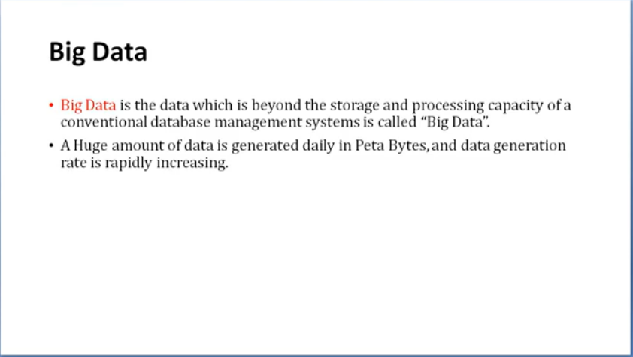

Slide 3
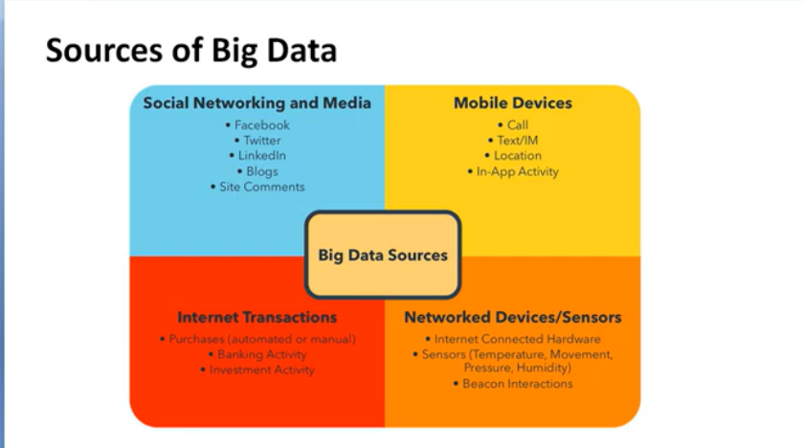

Slide 4
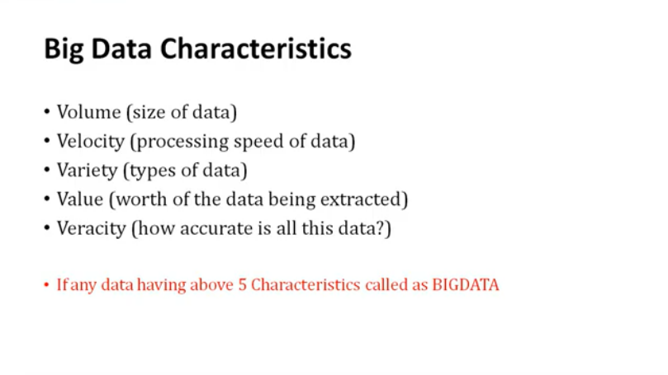

Slide 5
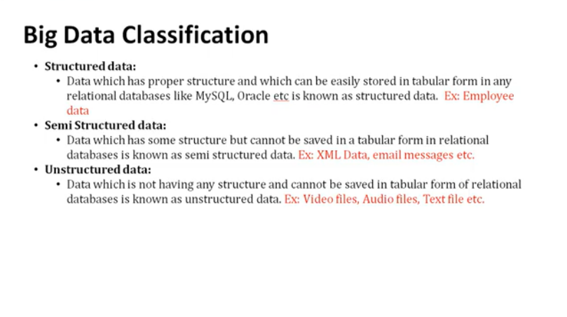

Slide 6


Slide 7
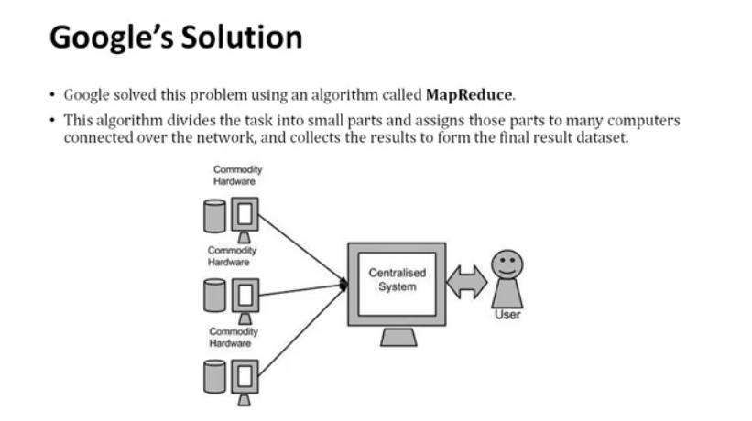

Slide 8
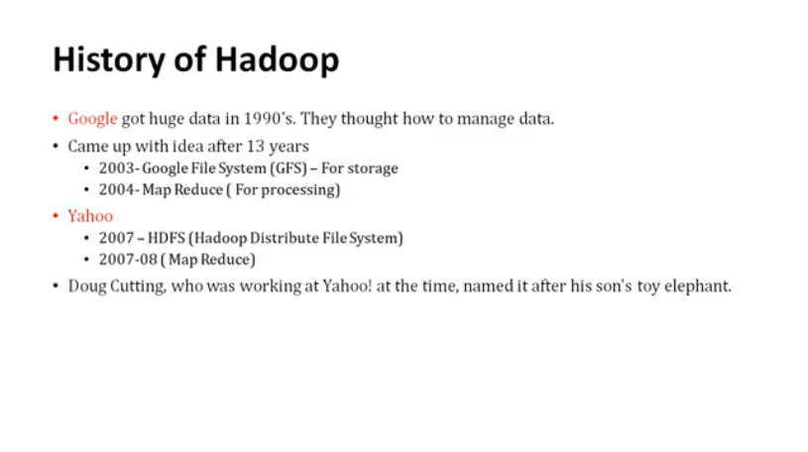

Slide 9
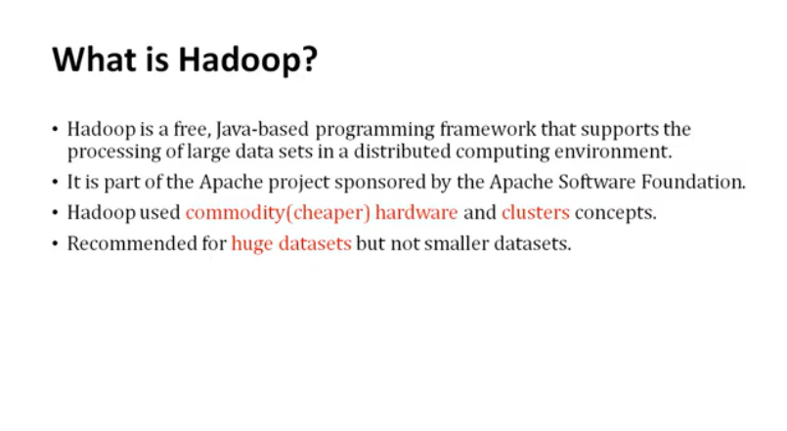

Slide 10
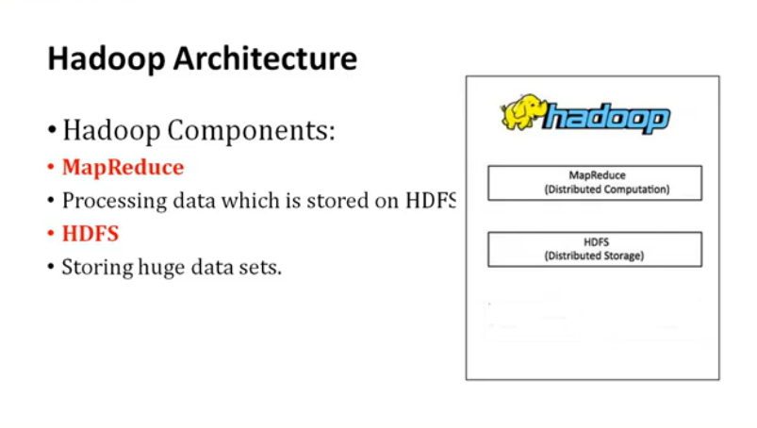

Slide 11
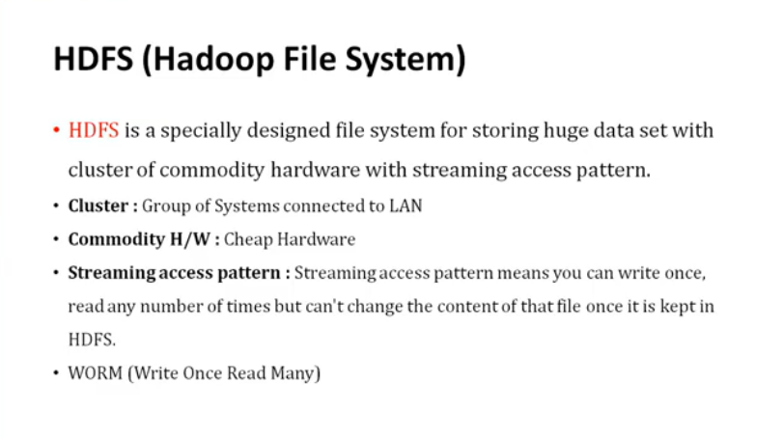

Slide 12
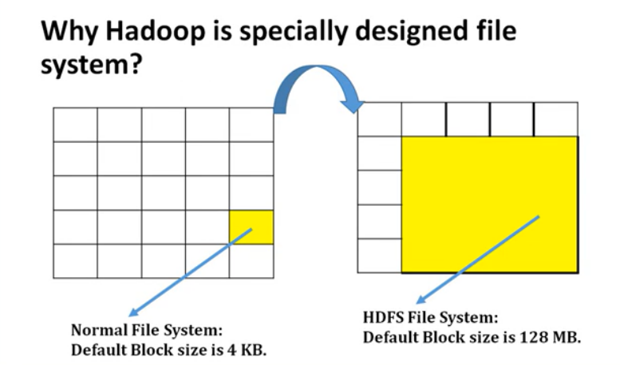

Slide 13
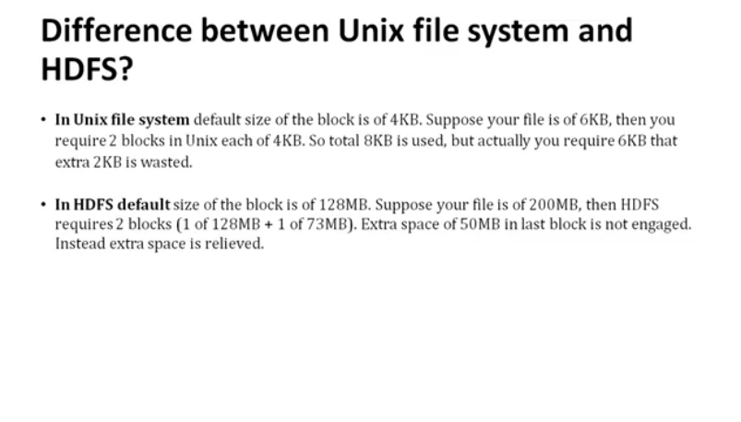

Slide 14
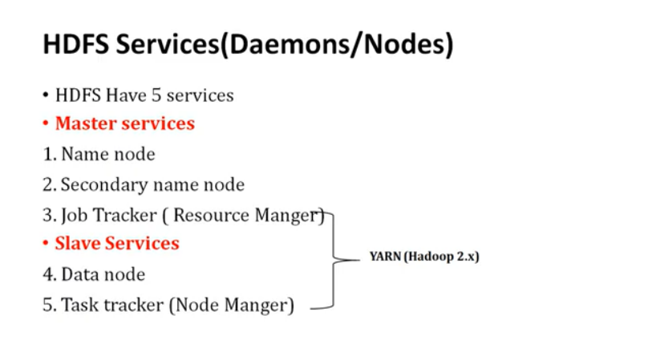

Slide 15
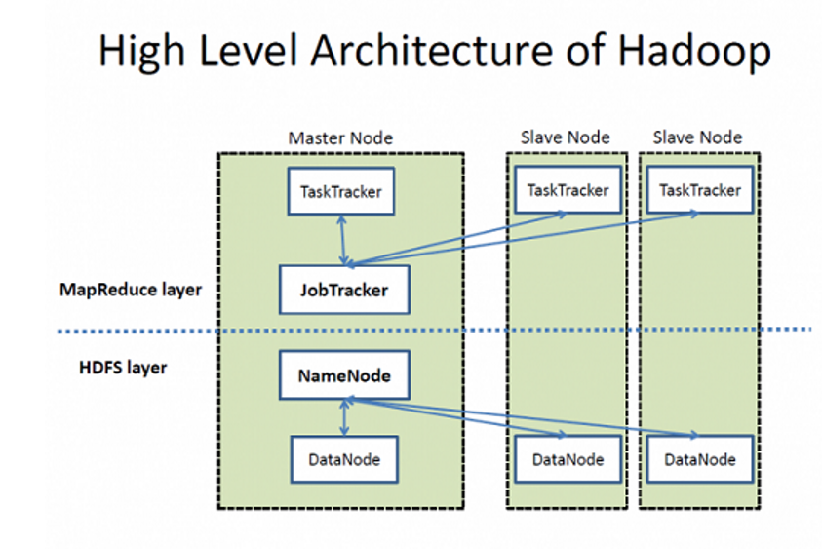

Slide 16
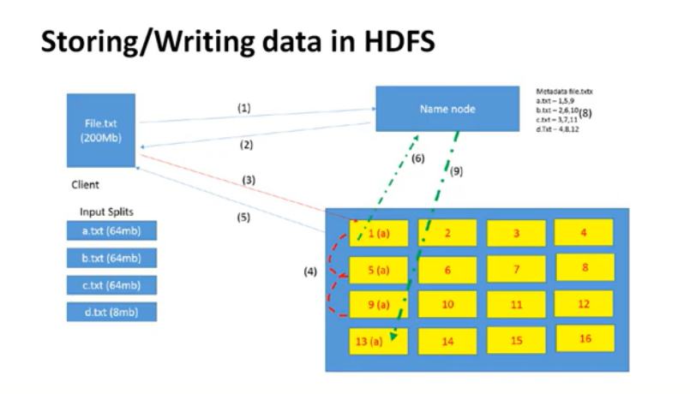
Hadoop 1.0, block size is 64MB In Hadoop 2.0, block size 128 MB

Slide 17
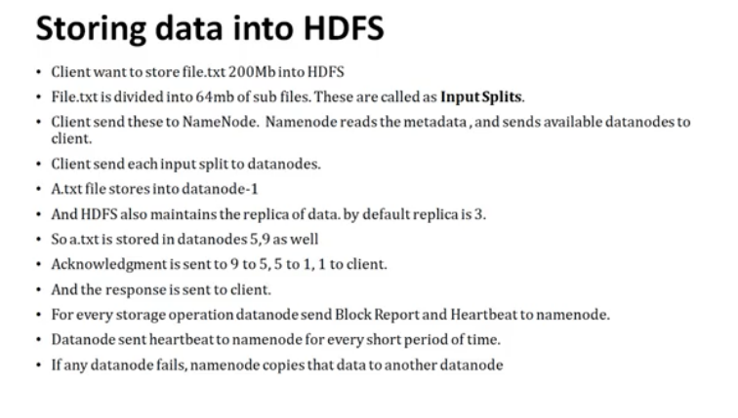

Slide 18
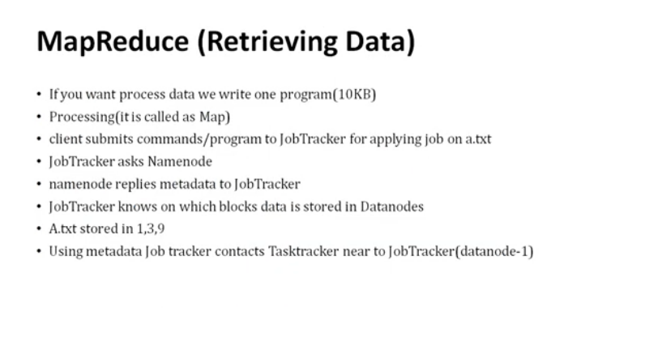

Slide 19
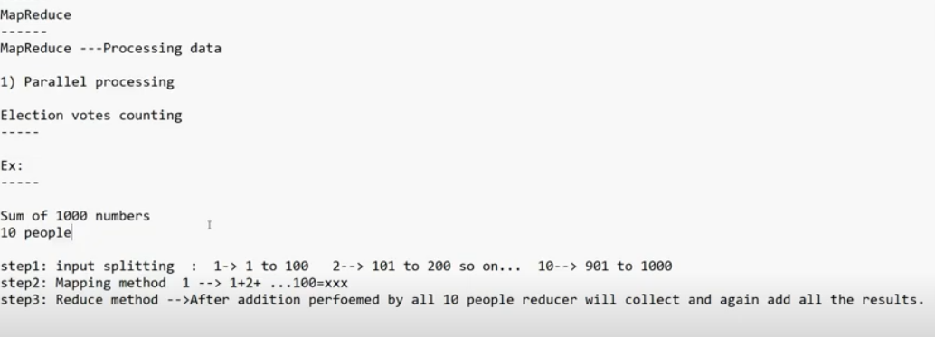
Example

Slide 20
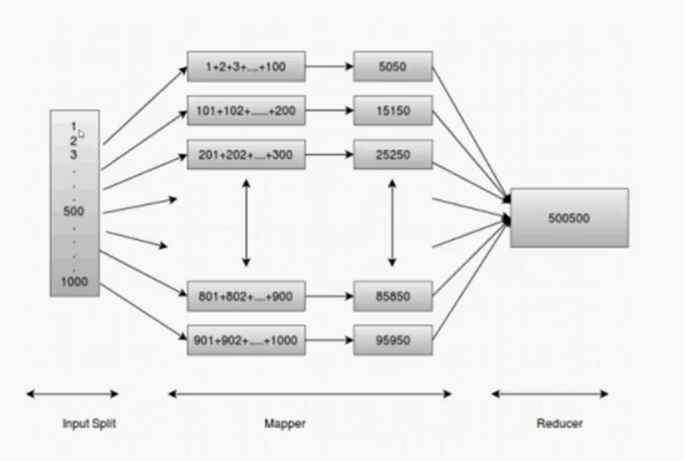
Continue….

Slide 21
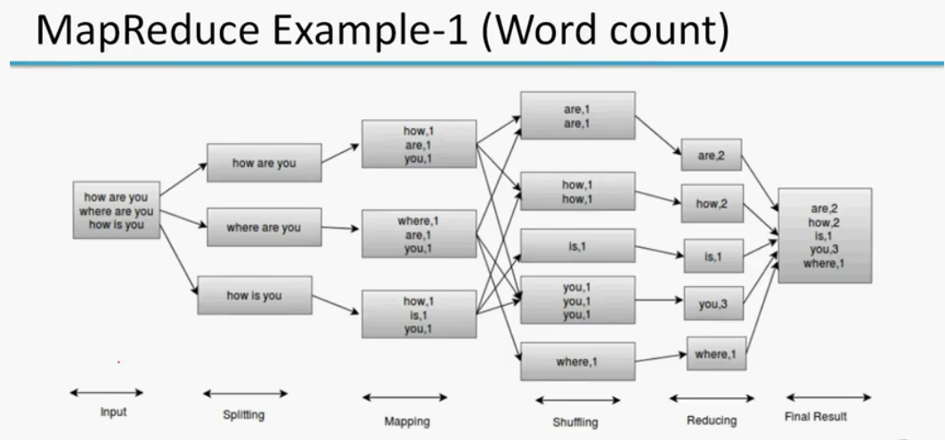
Word Count Example

Slide 22
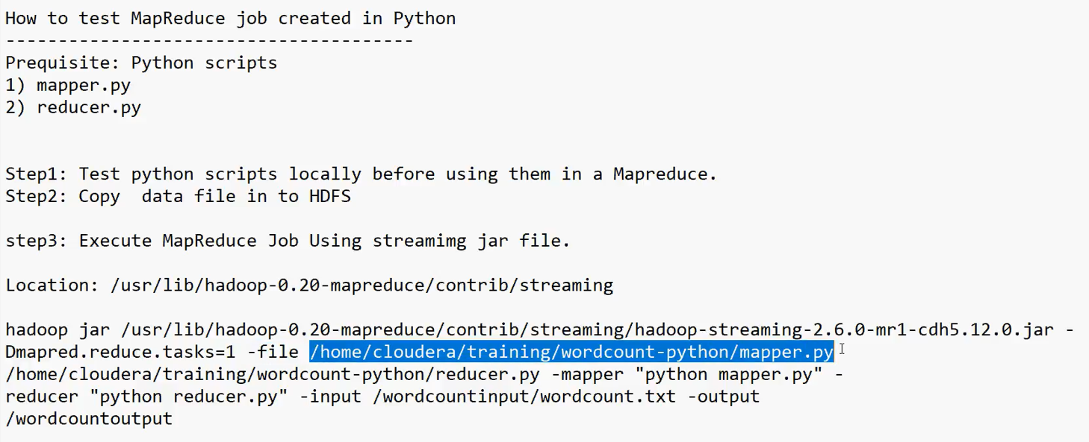
How to test Map reduce Job created in python

Slide 23
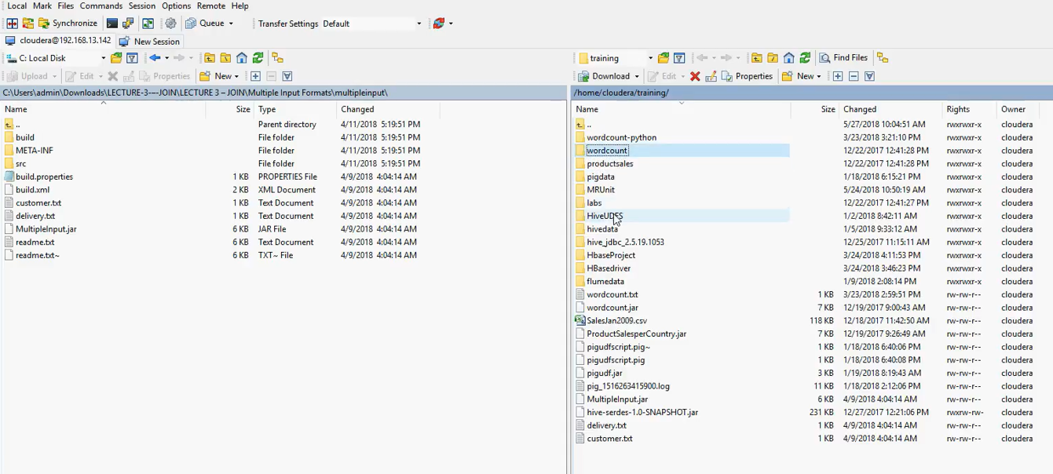
Win Scp – it is used to copy files from widows to unix and vice-versa

Slide 24
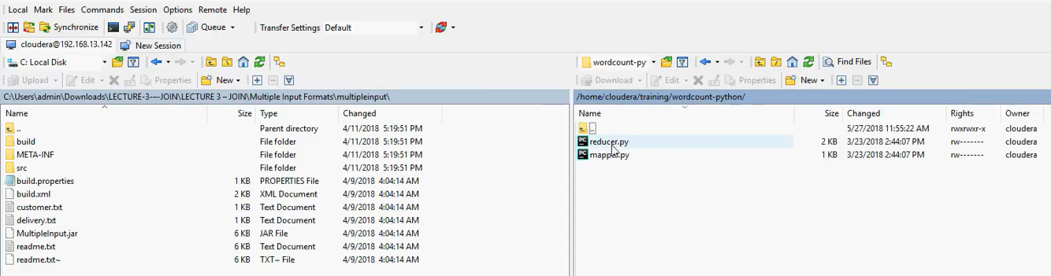
WinSCP Path: /home/Cloudera/training/wordcount-python/

Slide 25
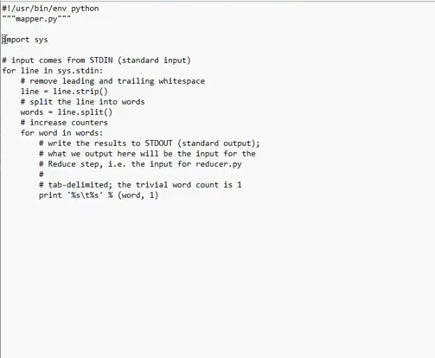
Mapper Script

Slide 26
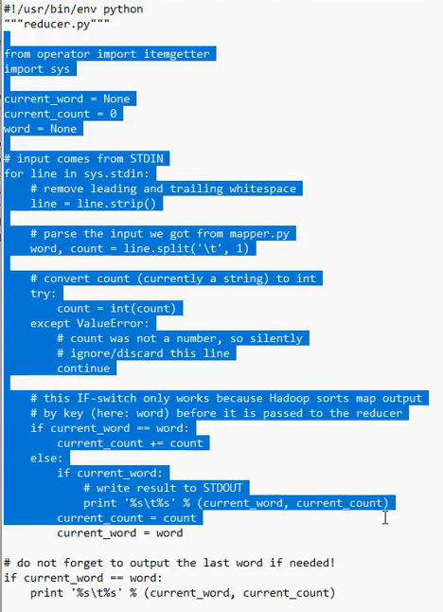
Reducer Script

Slide 27
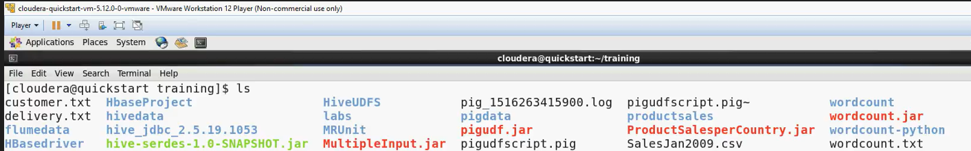
$echo “abc xyz abc prq mno abc” | python /home/Cloudera/training/wordcount-python/mapper.py | sort –k1,1 || python /home/Cloudera/training/wordcount-python/reducer.py

Slide 28
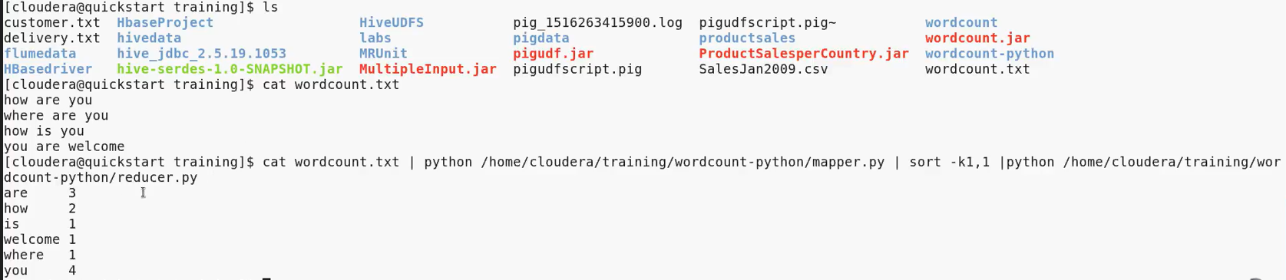

Slide 29
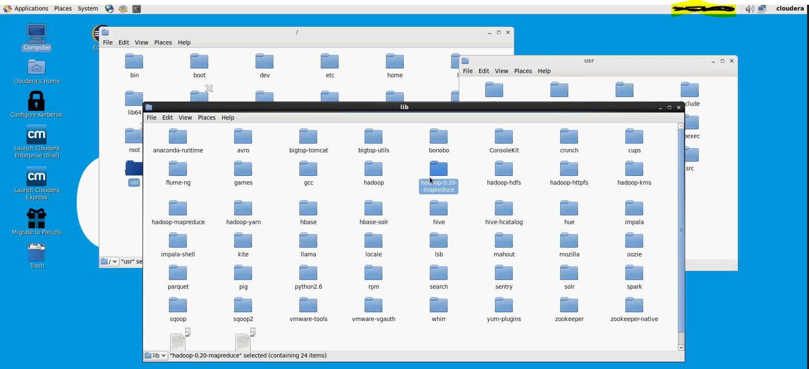
Hadoop jar file Location

Slide 30
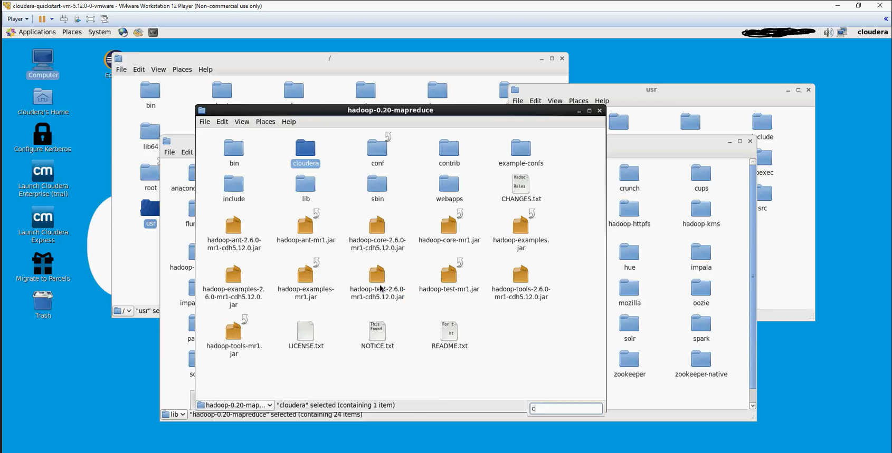

Slide 31
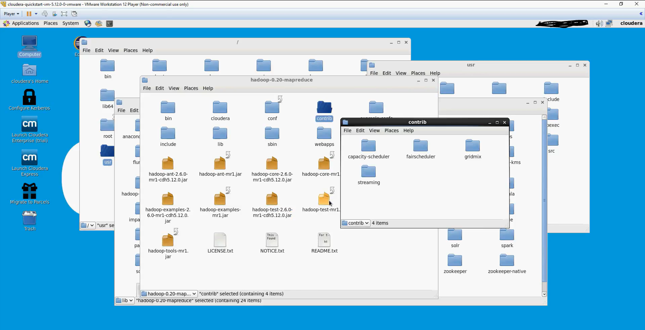

Slide 32
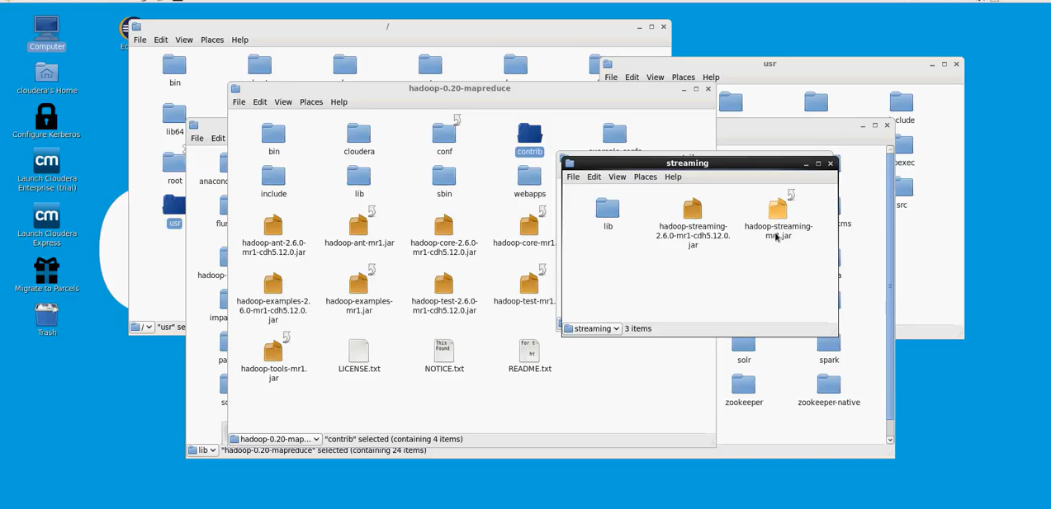

Slide 33
Preparing Hadoop Jar command along with MapReduce script
if scripts are written in Python then streaming Jar files are required to execute map reduce scripts.
along with Hadoop streaming jar files we need to pass mapper and reducer scripts to process the map reduce scripts
Hadoop Jar file along with mapper and reducer
hadoop jar /usr/lib/hadoop-0.20-mapreduce/contrib/hadoop-streaming-2.6.0-mr1-chd5.12.0.jar -Dmapred.reduce.task=1 -file /home/Cloudera/training/wordcount-python/mapper.py python /home/Cloudera/training/wordcount-python/reducer.py -mapper "python mapper.py" -reducer "python reducer.py" -input/wordcountinput/wordcount.txt -output /wordcountoutput

Slide 34
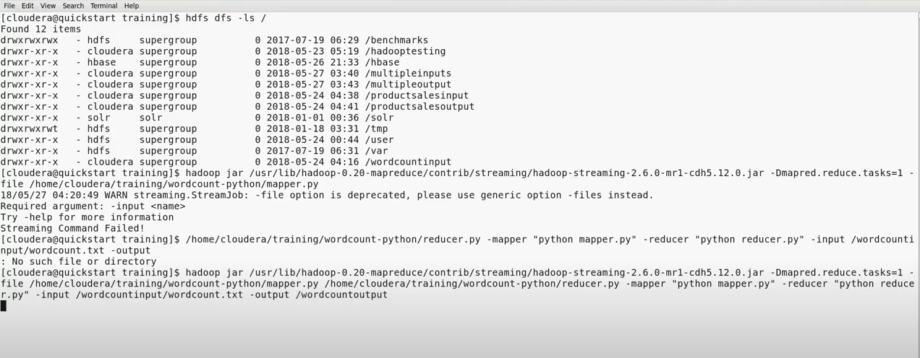
Using Hadoop terminal by using Hadoop commands

Slide 35
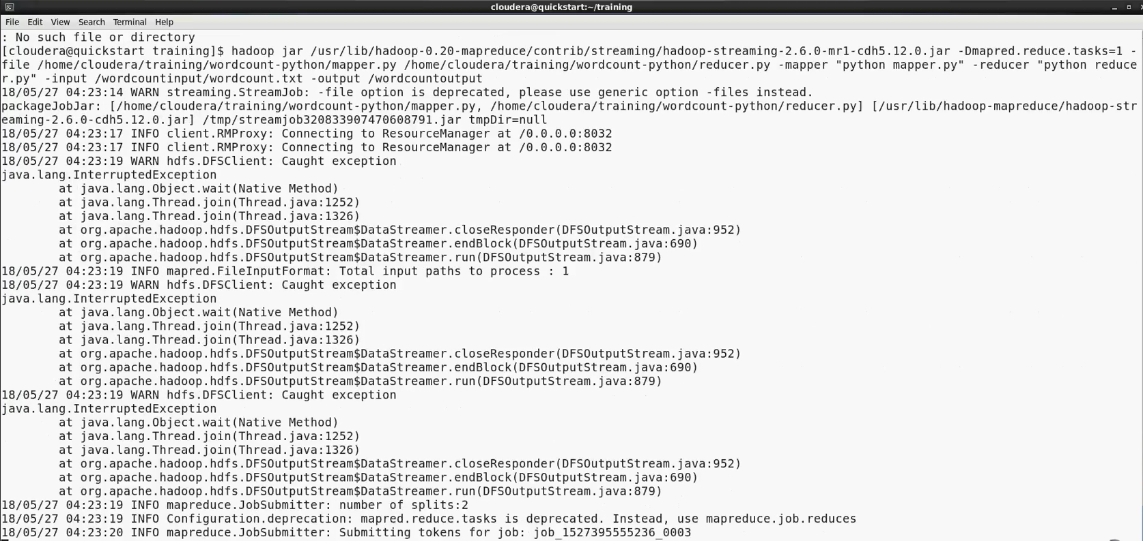

Slide 36
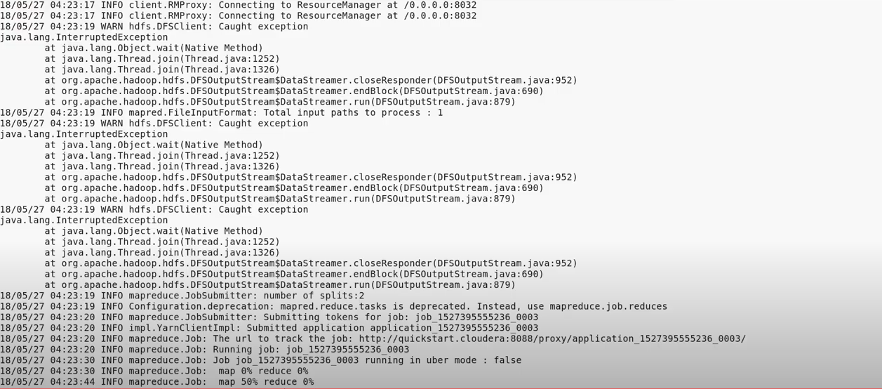

Slide 37
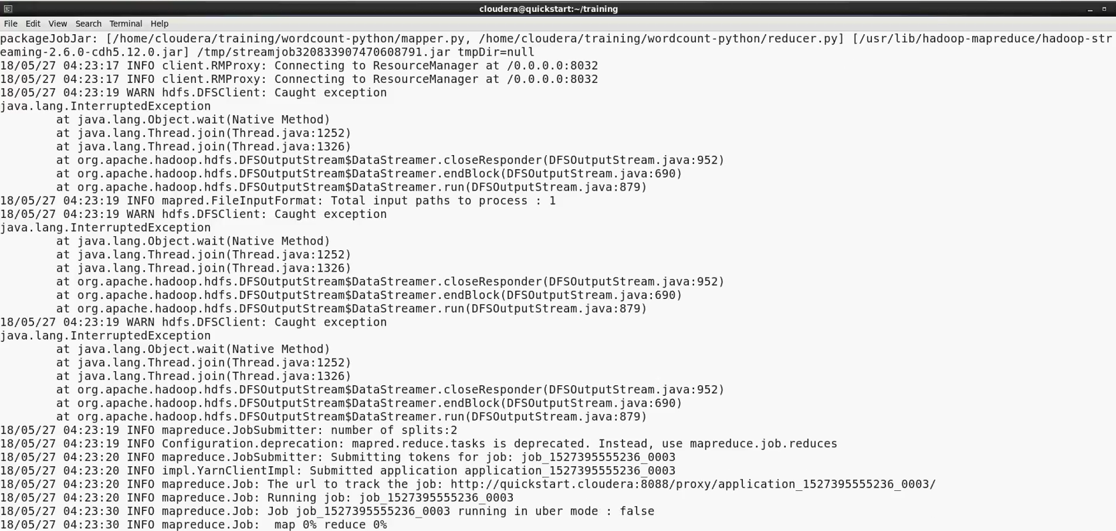

Slide 38
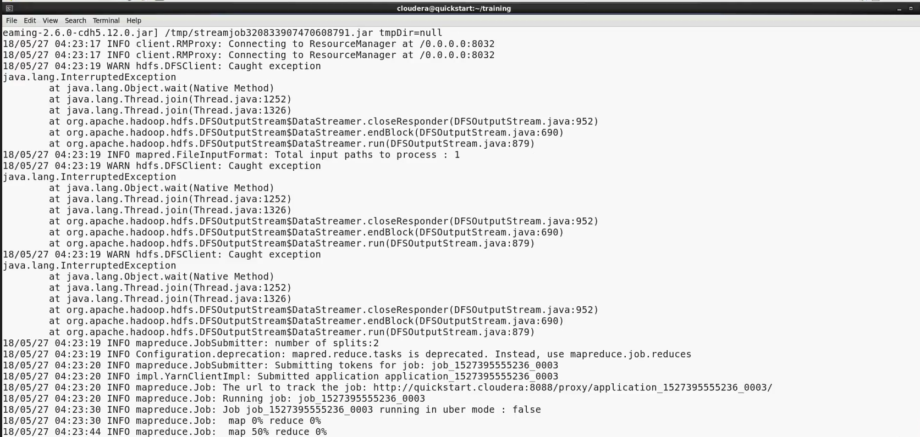

Slide 39
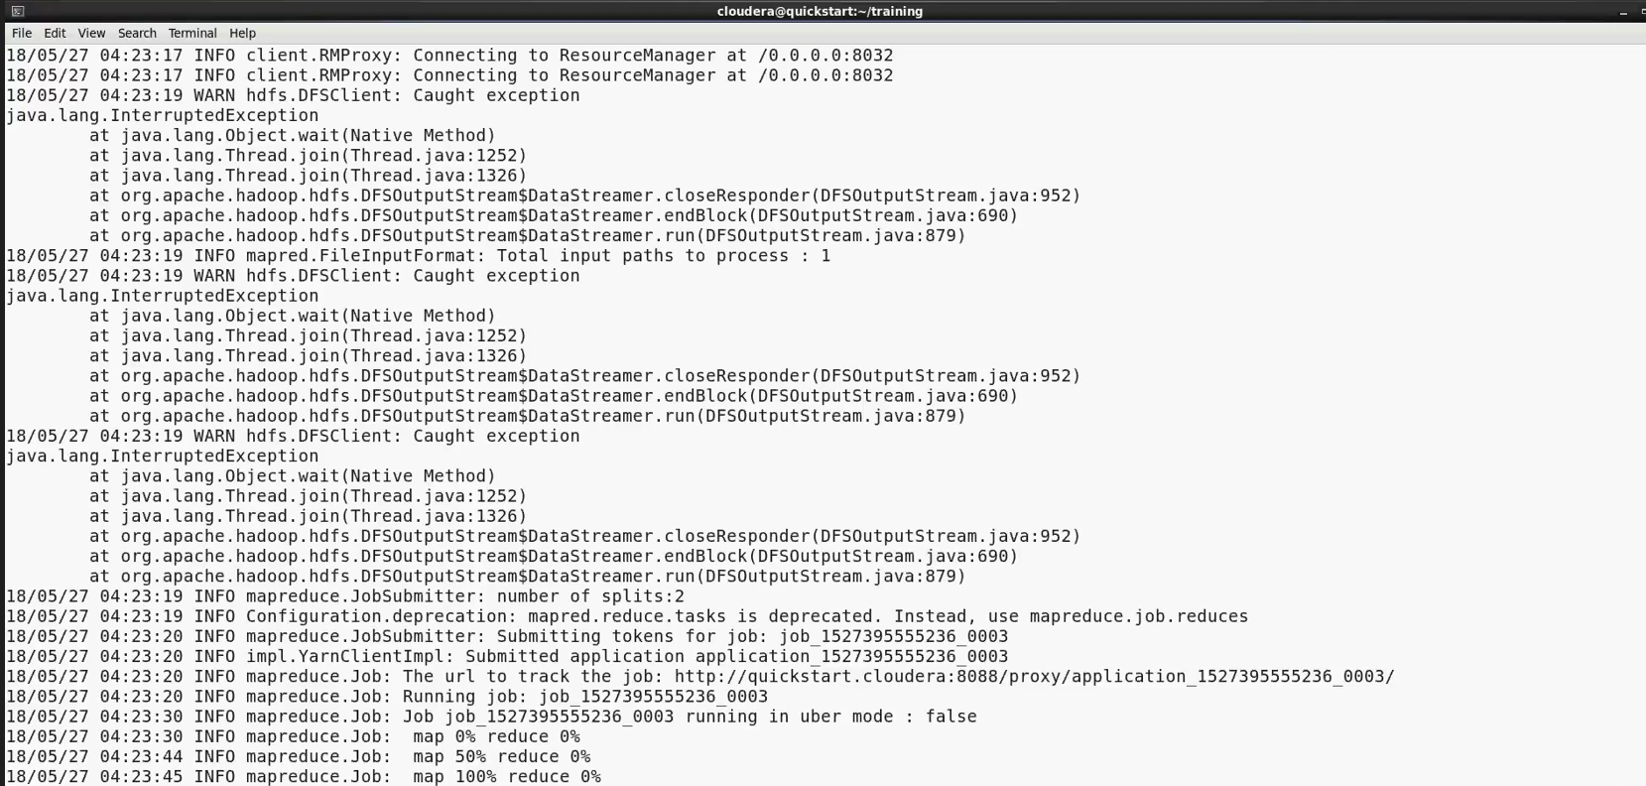

Slide 40
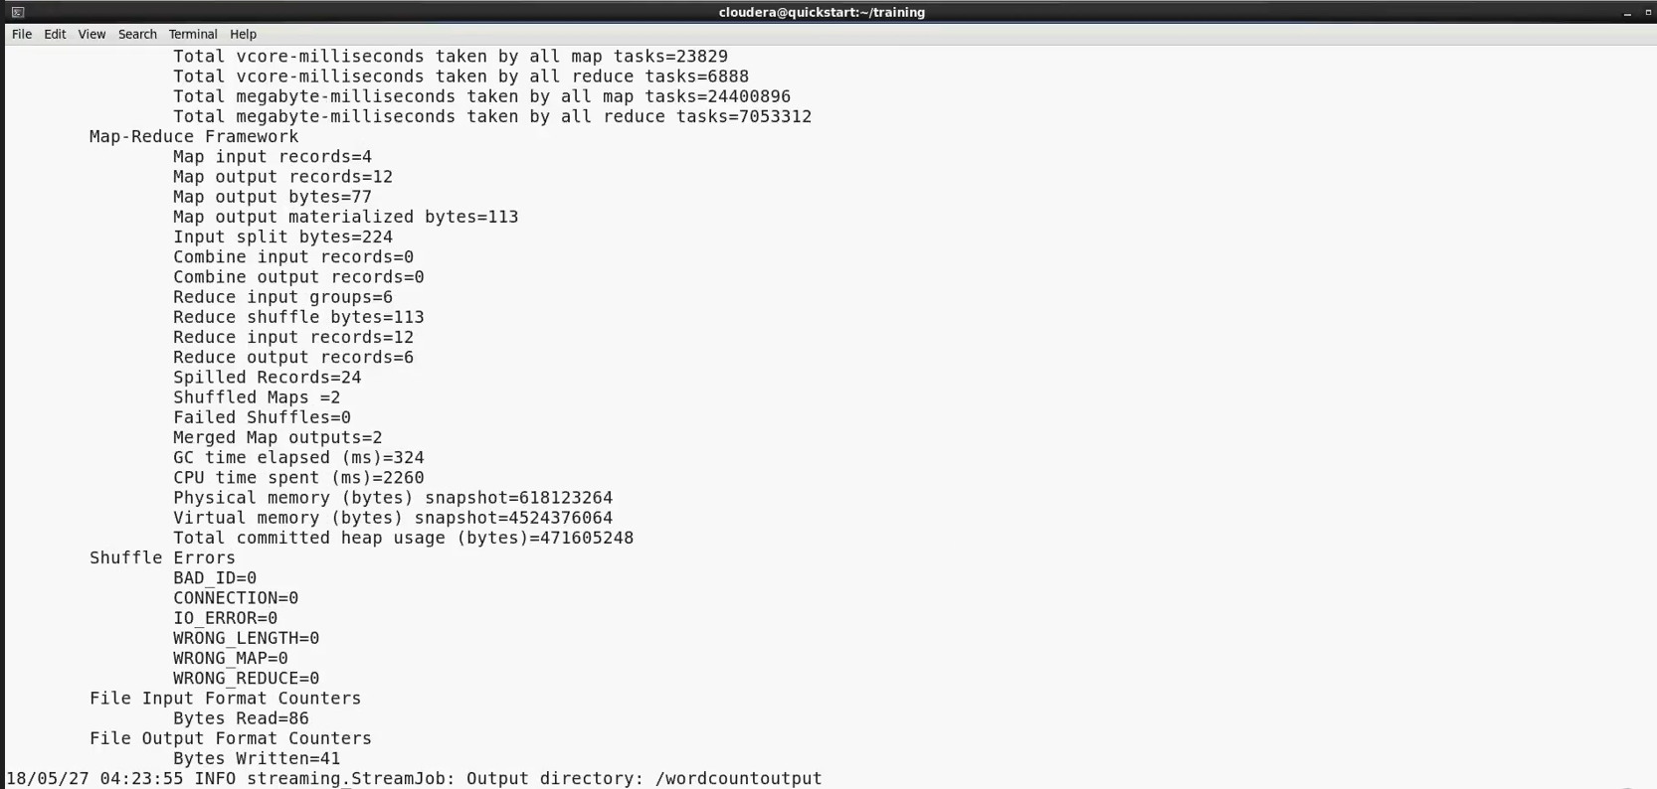

Slide 41
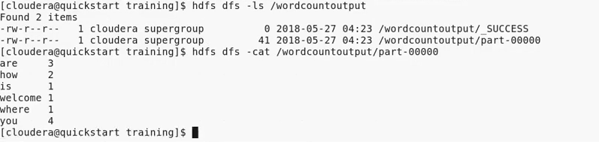

Slide 42
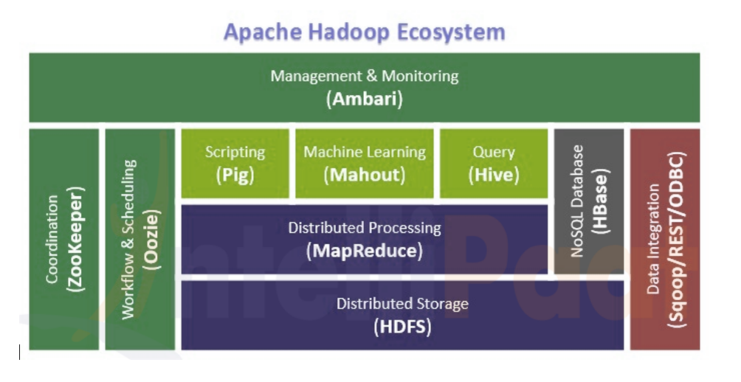
In Hadoop 2.x from onwards which supports YARN . Which helps to connect with different application like pig, Hive etc. Because Of YARN only it is possible to built an Apache Hadoop Ecosystem.

Slide 43
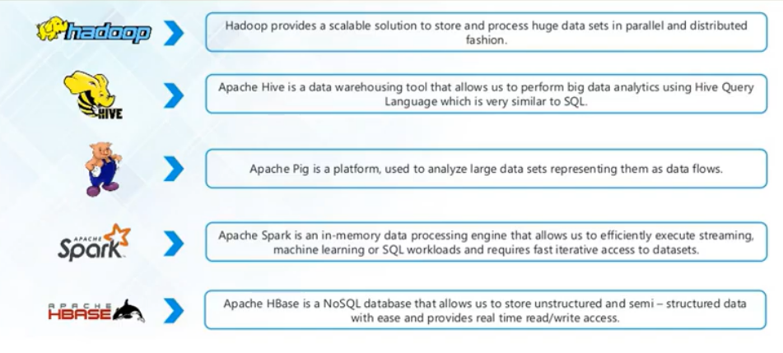

Slide 44
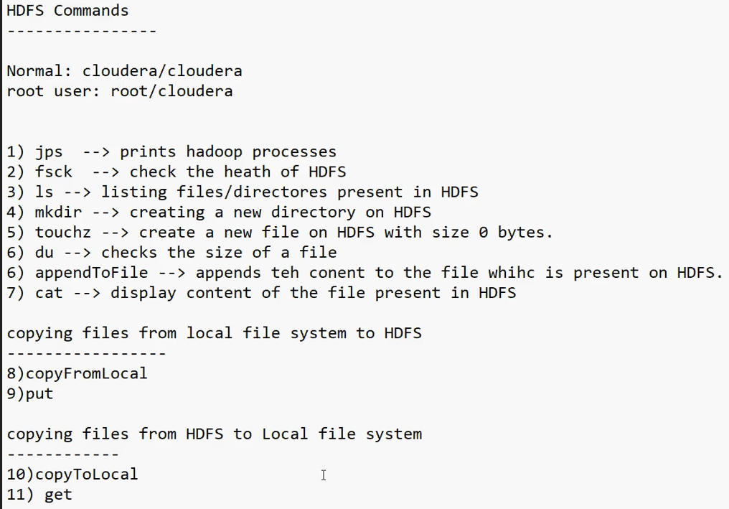
HDFS Commands

Slide 45
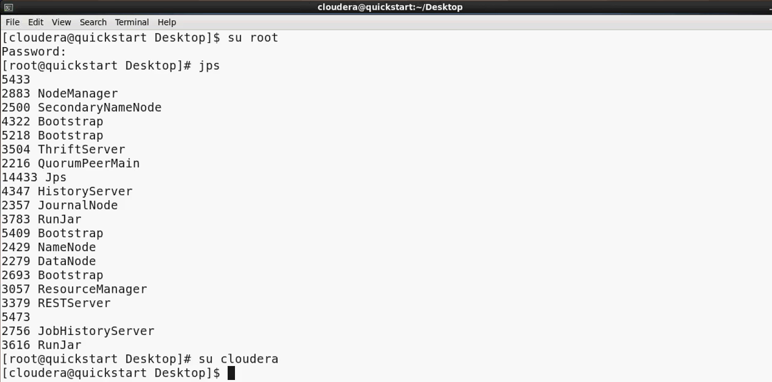
HDFS Commands To Operate any Hadoop commands we need to use always hdfs dfs –command or Hadoop fs –commands 1.JPS(Java Processes Status) JPS will show whether all the Hadoop services are up and running or not and print all the Hadoop processes.

Slide 46
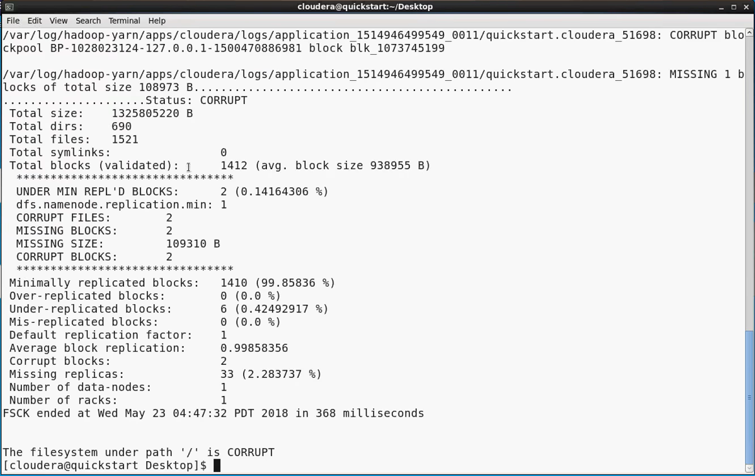
2.Fsck(File System Check) → Check the health of HDFS

Slide 47
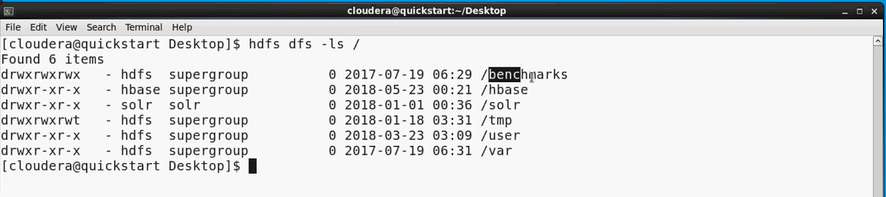
Always in Hadoop we need to use hdfs dfs or Hadoop fs along with Linux command –ls for normal Linux.

Slide 48
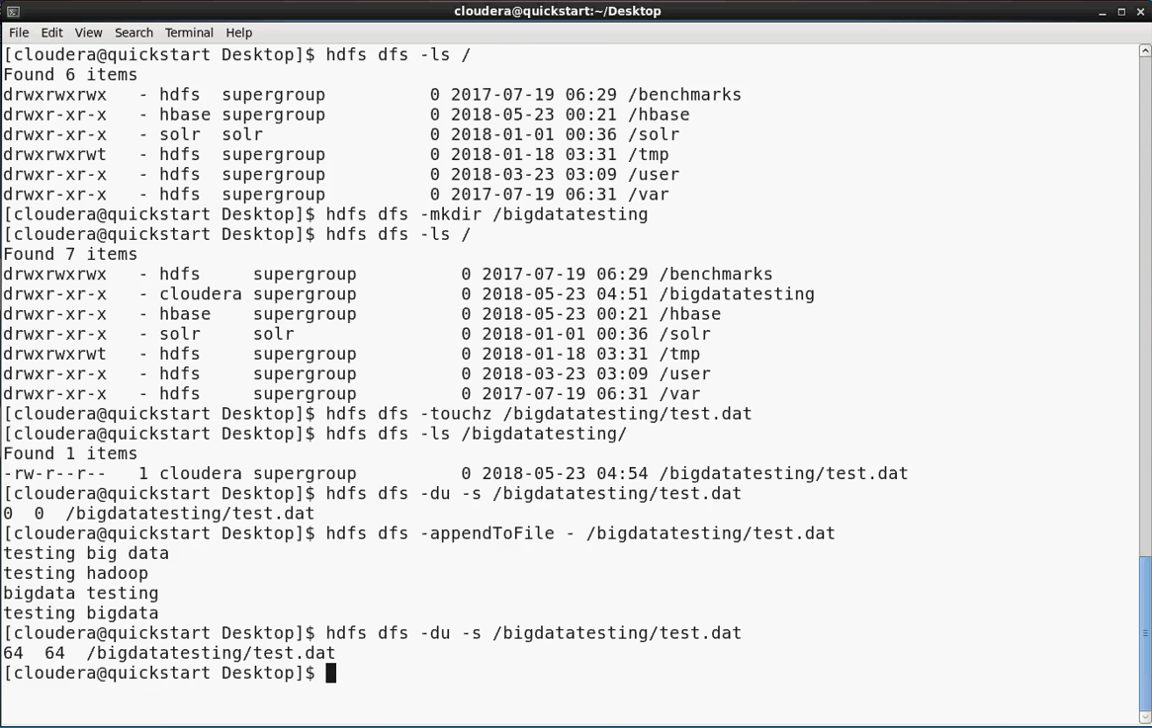

Slide 49
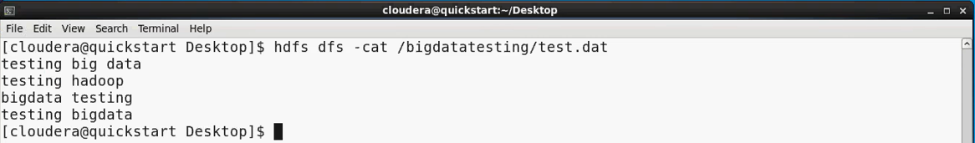
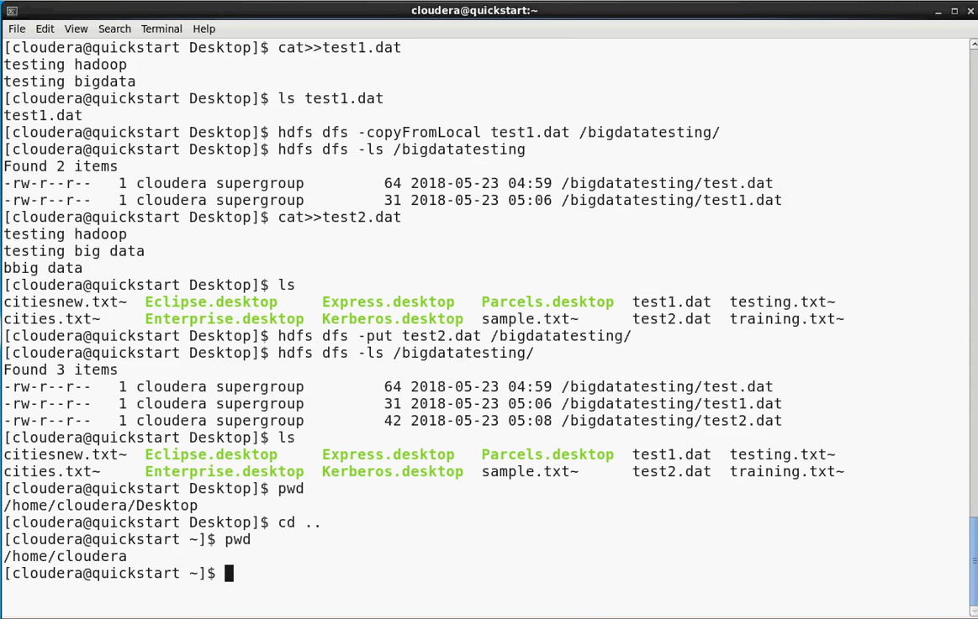

Slide 50
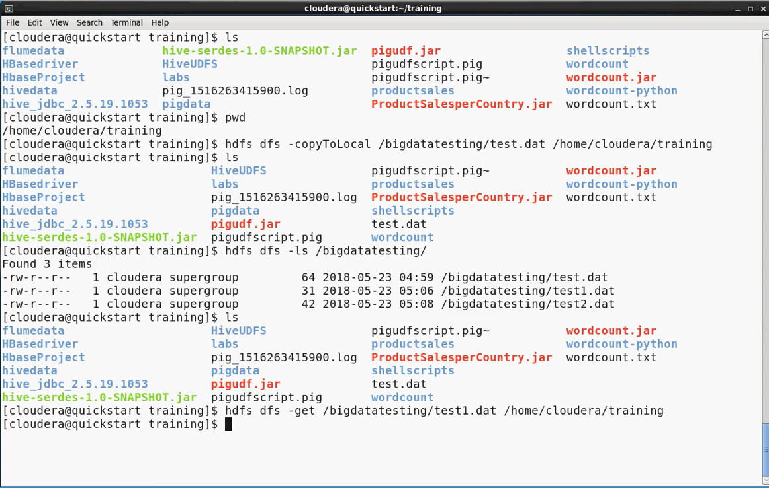

Slide 51
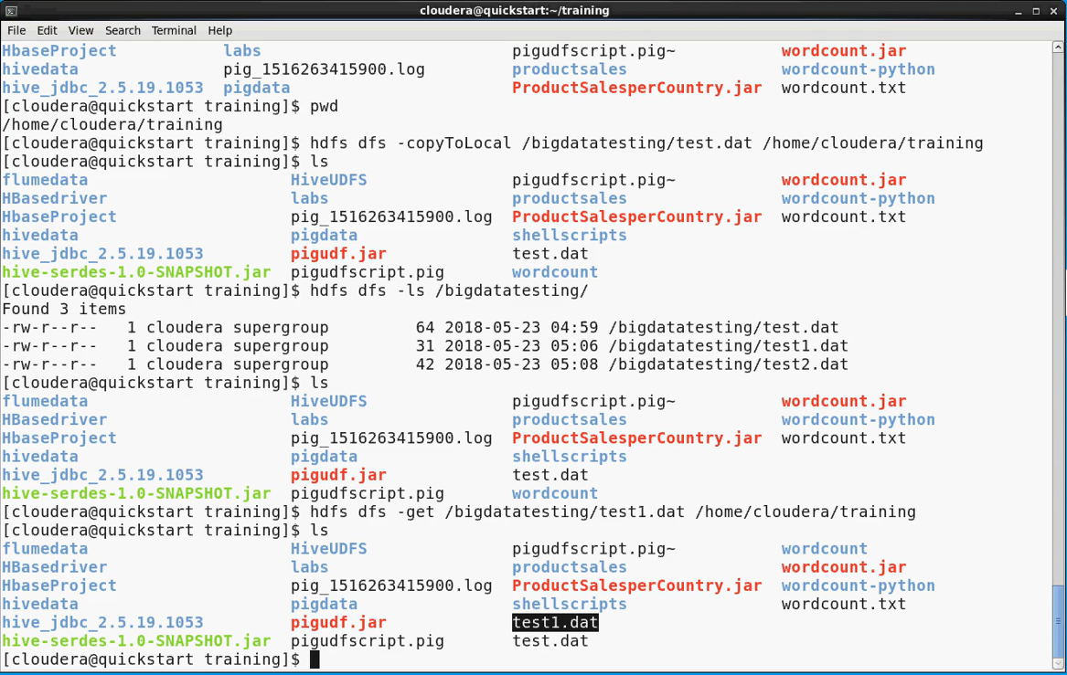

Slide 52
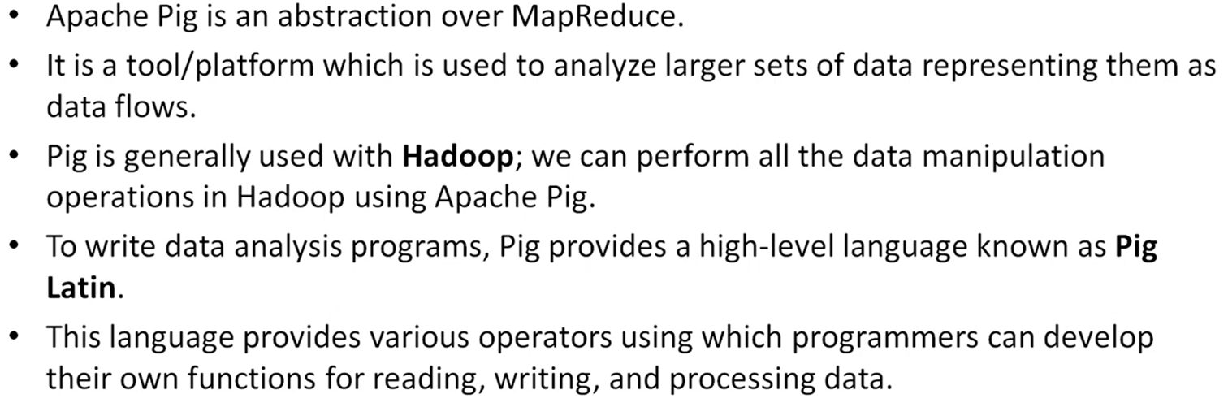
Pig Overview

Slide 53

Pig Features

Slide 54

Pig v/s Map Reduce

Slide 55

Pig Architecture

Slide 56

Continue…

Slide 57
Pig Execution mode
1.Local Mode :
Data will be used from local file system , commands will run locally.
[Cloudera@quickstart ~]$ pig –x local
2.MapReduce Mode (HDFS Mode):
Data Should be part of HDFS and Commands will run in MapReduce (Hadoop).
[Cloudera@quickstart ~]$ pig –x mapreduce or [Cloudera@quickstart ~]$ pig

Slide 58

1.Local Mode : Data will be used from local file system , commands will run locally. [Cloudera@quickstart ~]$ pig –x local

Slide 59


Slide 60

2.MapReduce Mode (HDFS Mode): Data Should be part of HDFS and Commands will run in MapReduce (Hadoop). [Cloudera@quickstart ~]$ pig –x mapreduce or [Cloudera@quickstart ~]$ pig

Slide 61


Slide 62


Slide 63


Slide 64

Pig Data Types

Slide 65

Complex Data Type

Slide 66


Slide 67
Execution Mechanisms(How many ways we can execute pig scripts)
1.Interactive Mode (in grunt shell)
In interactive mode individual commands are executed separately one after another
For Ex:
grunt> customers = LOAD ‘home/cloudera/training/pigdata/customers.txt’ USING pigstorage(‘,’);
grunt> DUMP customers;
2.Batch Mode (in UNIX / Linux prompt)
For Ex: [Cloudera@quickstart ~]$ cat Pig_Local.pig
customers = LOAD ‘home/cloudera/training/pigdata/customers.txt’ USING pigstorage(‘,’) as
(id:int, name: chararray, age : int ,address: chararray, salary : int);
DUMP customers;

Slide 68

1.Interactive Mode (in grunt shell) In interactive mode individual commands are executed separately one after another For Ex: grunt> customers = LOAD ‘home/cloudera/training/pigdata/customers.txt’ USING pigstorage(‘,’); grunt> DUMP customers;

Slide 69


Slide 70


Slide 71


2.Batch Mode (in UNIX / Linux prompt) – Local Mode For Ex: [Cloudera@quickstart ~]$ cat Pig_Local.pig customers = LOAD ‘home/cloudera/training/pigdata/customers.txt’ USING pigstorage(‘,’) as (id:int, name: chararray, age : int ,address: chararray, salary : int); DUMP customers;

Slide 72


Slide 73


Slide 74


Slide 75


2.Batch Mode (in UNIX / Linux prompt) – Mapreduce Mode For Ex: [Cloudera@quickstart ~]$ cat Pig_Global.pig customers = LOAD ‘user/cloudera/customers.txt’ USING pigstorage(‘,’) as (id:int, name: chararray, age : int ,address: chararray, salary : int); DUMP customers;

Slide 76


Slide 77


Slide 78


Slide 79

Pig Commands Ex

Slide 80
Script Example Write pig script Calculate those employees who work less than 20 hours and display in descending order
Employee = LOAD ‘people’ USING pigstoreg as (‘\t’) as
(empid: int,name : chararray, hours : int);
Part_time = FILTER Employee BY hours > 20;
Sorted = ORDER Part_time BY hours DESC;
DUMP Sorted;(To display contents of Bag on screen)
DESCRIBE Sorted;(To view the structure of Bag)

Slide 81

Write pig script Calculate those employees who work less than 20 hours and display in descending order

Slide 82

Script

Slide 83


Slide 84

Run output.pig

Slide 85

Output

Slide 86

Hive

Slide 87


Slide 88


Slide 89

Hive Data Flow

Slide 90


Slide 91


Slide 92


Slide 93


Slide 94


Create external table and insert data directly

Slide 95


Slide 96

Create external table and load the data from local system.

Slide 97


Slide 98


Slide 99


Slide 100
INTERNAL OR MANAGED TABLE EXTERNAL TABLE
1.By default, Hive creates an Internal or Managed Table. 1.Use EXTERNAL option/clause to create an external table
2.Hive owns the metadata, table data by managing the 2.Hive manages the table metadata but not the underlying file. lifecycle of the table.
3.Dropping an Internal table drops metadata from Hive 3.Dropping an external table drops just metadata from Meta store and files from HDFS. Meta store with out touching actual file on HDFS.
4.Hive supports ARCHIVE, UNARCHIVE, TRUNCATE, 4.Not supported.
MERGE, CONCATENATE operations.

Slide 101


Slide 102


Slide 103


Slide 104


Slide 105


Slide 106


Slide 107

Aginity Pro

Slide 108


Slide 109


Slide 110
END

